Slide 1
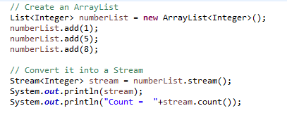
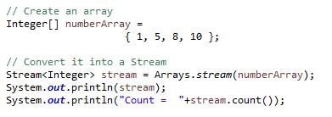
Creating a Stream
A stream is just a sequence of items.
In Java 8, every class which implements the java.util.Collection interface has a stream method which allows you to convert its instances into Stream objects. Therefore, it’s trivially easy to convert any list into a stream. Here’s an example which converts an ArrayList of Integer objects into a Stream
If you prefer arrays over lists, you can use the stream method available in the Arrays class to convert any array into a stream.

